Slide 1
Committee of Intercollegiate Athletics
Beverly Marshall
Faculty Athletics Representative

Slide 2
What is FGR and GSR?
FGR=Federal Graduation Rate
Essentially measures % of students who complete BA/BS from initial school within 6 years
Counts all transfers as academic failures
Only Student Athletes receiving financial aid are counted as student athletes

Slide 3
AU FGR for Males by Ethnicity
Year | FGR—Males | FGR – White Males | FGR—African American Males | FGR- White Male Student Athletes | FGR—African American Male Student Athletes
2011-12 | 72% | 74% | 54%
2010-11 | 70% | 72% | 61% | 65% | 75%
2009-10 | 68% | 70% | 50% | 70% | 56%
2008-09 | 67% | 68% | 53% | 64% | 41%
2007-08 | 63% | 67% | 40% | 63% | 50%
2006-07 | 66% | 71% | 35% | 55% | 60%
2005-06 | 63% | 68% | 34% | 48% | 43%

Slide 4
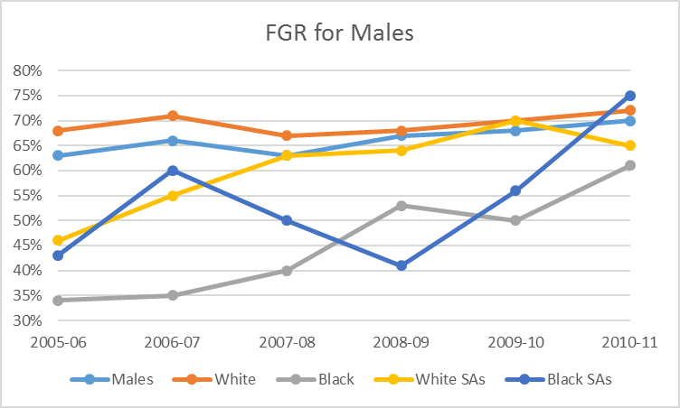
Male Graduation Trends

Slide 5
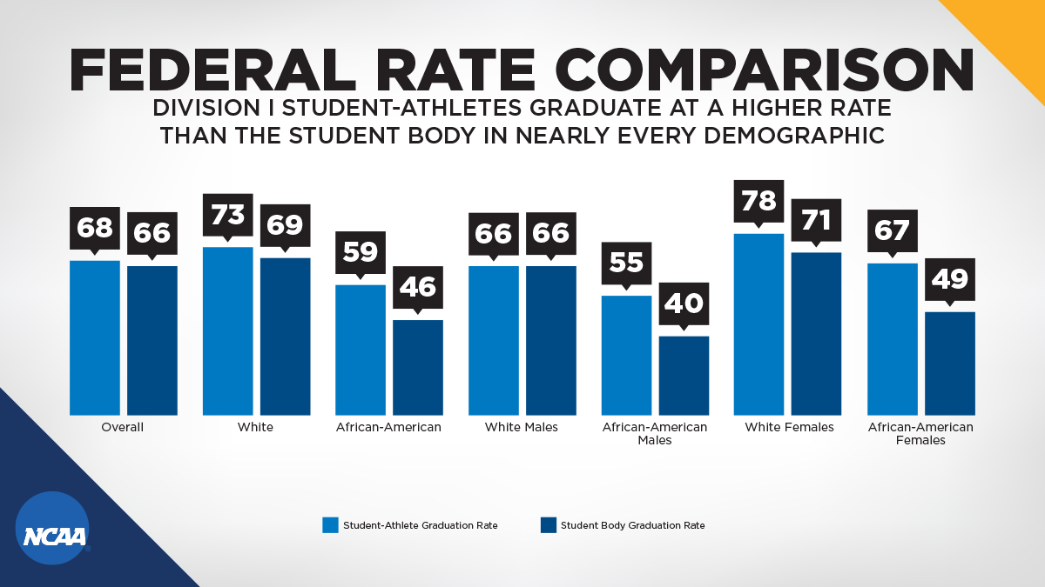

Slide 6
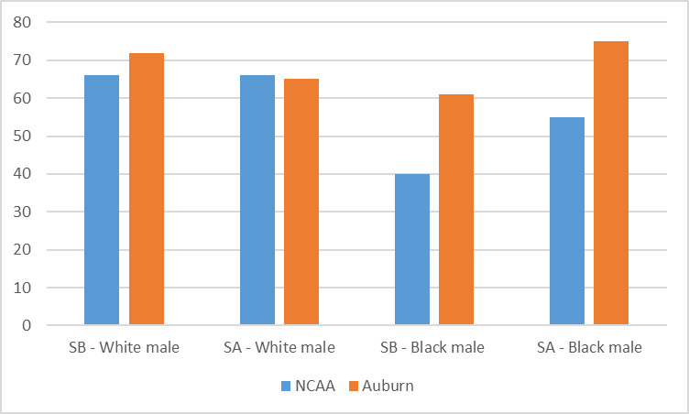
FGR Males compared to NCAA

Slide 7
AU FGR for Males by Ethnicity - 4 year averages
Year | FGR—Males | FGR – White Males | FGR—African American Males | FGR- White Male Student Athletes | FGR—African American Male Student Athletes
2011-12 | 72% | 74% | 54%
2010-11 | 67% | 69% | 50% | 65% | 57%
2009-10 | 66% | 69% | 42% | 62% | 52%
2008-09 | 65% | 68% | 39% | 58% | 49%
2007-08 | 64% | 68% | 37% | 55% | 50%
2006-07 | 64% | 68% | 37% | 58% | 51%
2005-06 | 63% | 66% | 38% | 63% | 42%

